Slide 1
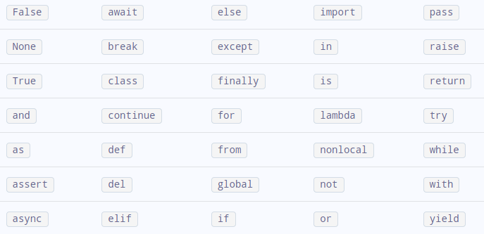
Identifier and keyword
Click to Keyword
An identifier is a name having a few letters, numbers and special characters _ (underscore). It is used to identify a variable, function, symbolic constant and so on
Ex : -

